Slide 1
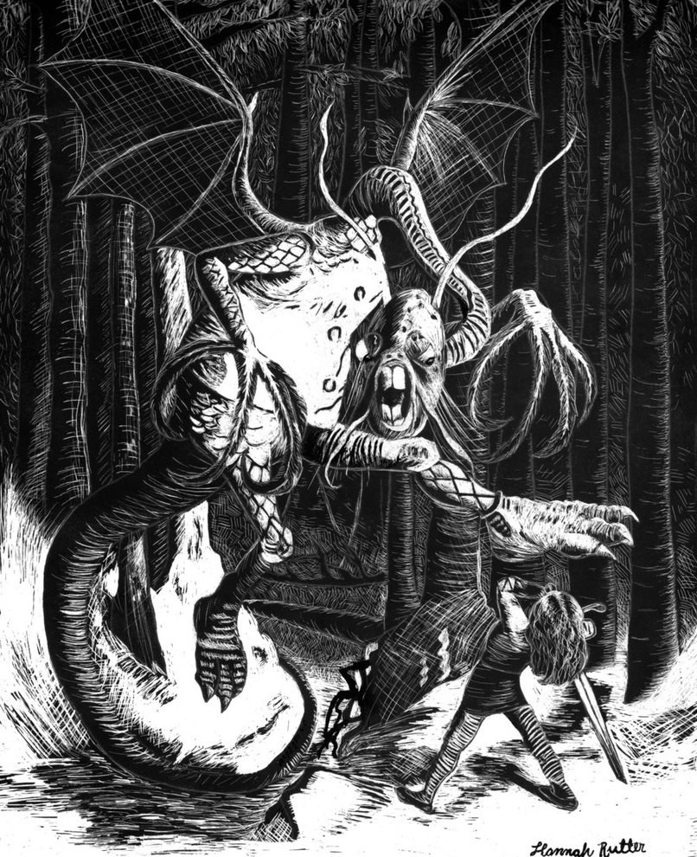
Jabberwocky Quest
By Ben, Eben, and Joshua

Slide 2
Description
A Text-Based RPG, Inspired From Alice In Wonderland Lore
Idea For Main Boss From The Jabberwocky Poem
Uses Classes, Functions, Arrays, Objects(Defined In Header Files), Header Files, While Loops, Chars, Boolean Statements, And If Else Statements
Lots & Lots Of Comments!

Slide 3
Challenges
Getting Constructors To Work Properly
Learning How To Use Object Oriented Programing Correctly
Learning How To Use Pointers
Game Was Larger In Scale Than We Expected

Slide 4
Solutions pt. 1
Main Function: Is A For Loop, Containing Several While Loops And If Else Statements, And Calling Many Functions From Header Files And Other Source Files.
Battle Function: Initializes A Battle Between The Player & A Randomized Monster Or Mini-Boss
Console Delay Function: Causes Text To Be Displayed 1 Line At A Time Without User Input
Monster Class: Has Stats & Descriptions of All Monsters

Slide 5
Solutions pt. 2
Player Class: Has Stats And Special Abilities Of Main Character
Bestiary Function: Holds All Of Our Monster Classes In A 2-D Array To Be Called For Battles
Storyline Function: Holds All Storyline Text, Each Section(Chapter) Is Then Called Individually To Main Function

Slide 6
Cool Factor
Takes An Already Well Known Fictional Lore And Builds On It Even More
Uses Imaginary Creatures With Crazy Names
Has An Intriguing Storyline That Builds On Already Known Characters
Player Choice Determines What Mini-Bosses & Buffs The Player Encounters
Battling Lots Of Randomized Monsters, Making Each Playthrough Unique
Fun Fact! 90% Of the Cheshire Cat’s Dialogue is Taken From The 1865 Book: Alice’s Adventures In Wonderland

